Slide 1
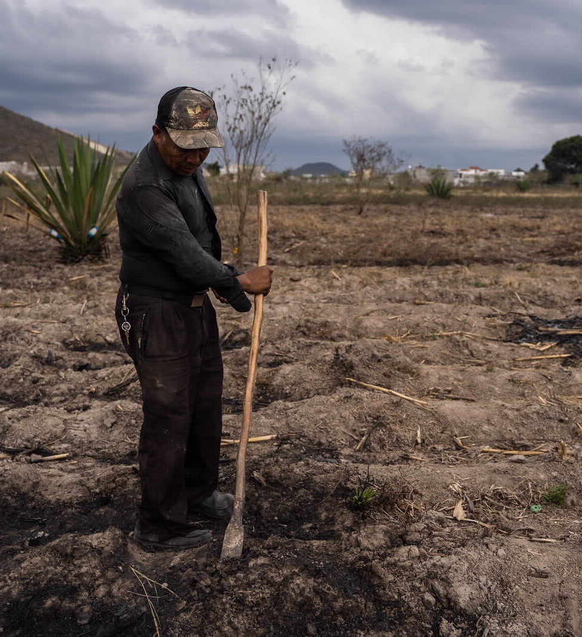
PADF’s Greenhouse Gas Emissions
Town Halls
December 2021
Pan American
Development Foundation
A hemisphere of opportunity. For all.

Slide 2
What you will find in this slide deck
Background on the threat of climate change (slide 3)
PADF’s timeline for calculating our greenhouse gas emissions (slide 4)
PADF’s commitments to combat climate change (slides 5 and 6)
PADF’s FY 2019 greenhouse gas emissions (slides 7-13)
What will happen next to carry out our climate change commitments (slide 14)
Annexes (slides 16-19)

Slide 3
We are living in a climate crisis
As of 2021, we have already reached 1.1°C of global warming compared to pre-industrial levels.
A report released in September by the World Bank estimates that by 2050, climate change could lead to 17.1 million people (2.6% of the population) in LAC migrating within their own countries. This could be reduced by 80% if we act now to reduce GHG emissions.
A report by FAO, ECLAC and ALADI found that climate change will affect crop yields, local economies, and food security in LAC. The report finds that the agricultural sector is the most affected by climate change.
All governments and organizations, including NGOs like PADF, are being encouraged to measure, reduce, and offset their carbon emissions.
PADF is a pioneering organization taking the lead.

Slide 4
PADF’s Timeline to tackle GHGs
April 2020
March 2021
June 2021
December 2021
Winter/Spring 2022
PADF signs the InterAction NGO Climate Compact committing us to a baseline measurement
Baseline study is completed and PADF brings on dedicated staff person to focus on climate change
PADF creates a Climate Action Plan setting Science-Based Targets for emissions reduction
Consultant Na’im Merchant begins FY 2019 Baseline study
PADF joins CAD and calculates emissions from FY 2020 and FY 2021

Slide 5
In 2020, PADF signed the NGO Climate Compact
The NGO Climate Compact: Commitments toward Environmental Action and Sustainability
“A pledge to urgently work to address climate change and our recognition that the environment is central to achieving our missions to serve the world’s poorest and most vulnerable people.”
As signatories, by the end of 2022, PADF will:
Assess major categories and sources of greenhouse gas emissions, water usage, and waste at our organization’s headquarters, country offices, and field offices;
Propose actions that our organization will take to reduce emissions and waste, and begin implementing them.
Read the entire NGO Climate Compact here
Notes:
There are many bullets in the entire compact, but these one are key ones.

Slide 6
In December 2021, PADF joined CAD
Membership requires us to:
Establish a Climate Action Plan in the first 6 months and report progress annually
Measure GHG emissions annually with a commitment to increasing accuracy and completeness of measurement
Reduce greenhouse gas emissions, 30% reduction by 2030
Mitigate hard-to-avoid emissions through a $50/ton carbon price starting in 2025. CAD will manage a pooled, expert-mediated fund that will perform the due diligence necessary to invest in high-quality carbon removal and mitigation activities
Liaise with the alliance, engage with other members, and support peer learning
PADF became a member of CAD on December 1st, 2021
A membership organization started in 2021 for development organizations ready to engage in climate change accountability

Slide 7
Baseline Methodology
Created a spreadsheet of all expenditures under specific cost categories
Scope 1: Fossil fuel consumption
Scope 2: Electricity consumption
Scope 3.6: Business Travel
Air Tickets – 71000
Lodging – 72000
Shipping Related – 61217
Taxi/Other Transportation – 75200
Transportation – 64100
Fuel – 64300
Utilities – 66300
In some cases, used kWh of electricity
Notes:
Scope 1: Only HQ, Colombia, El Salvador, Haiti, Honduras, Guatemala, and Venezuela buy fuel
Scope 2: Top 5 consumers are HQ, Colombia, El Salvador, Haiti, and Honduras

Slide 8
Our FY 2019 GHG Emissions
GHG Protocol Scopes Measured | mtCO2e
Scope 1: Direct emissions from fossil fuels | 38
Scope 2: Indirect emissions from purchased electricity | 367
Scope 3.6: Business travel | 788
Total | 1,192
Notes:
Our measurement is in metric tons of CO2 equivalent.
The world emits 36,400,000,000 metric tons of CO2 a year. PADF contributes 0.0003% of global emissions

Slide 9
Country-office breakdown
Notes:
Note: HQ is s high because of one of the limitations, that we had to put a lot of flights into HQ

Slide 10
Emissions by Staff Headcount
Office | # Permanent Staff (2019)
HQ | 60
Colombia | 221
El Salvador | 15
Haiti | 68
Honduras | 3
Guatemala | 4
St. Lucia | 1
Mexico | 5
Venezuela | 17
Guyana | 0
Ecuador | 7
Peru | 3
Belize | 1
Jamaica | 2
Trinidad & Tobago | 1
Nicaragua | 3
Bahamas | 1
Total | 412
Notes:
Note that even though Honduras and St. Lucia are higher than HQ with emissions per staff member, that is because there are only 3 and 1 staff person accordingly

Slide 11
Compared to Development Organizations
The other organizations in this graph are select members of the Carbon Accountability in Development Collective:
Clinton Health Access Initiative
Partners In Health
EvidenceAction
PIVOT
Integrate Health
Malaria No More
Give Directly
Many of these organizations work primarily in Africa which can increase scope 3.6 emissions
Notes:
These organizations have asked that these baselines be kept confidential as they are not yet publicly reported

Slide 12
Compared to Other Organizations
Other Organization | Emissions by staff headcount in 2019 | Notes
United Nations | 6.5 mtCO2e | 45% of emissions from air travel, 43% from facilities, 12% from other travel.
World Resources Institute (WRI) | 3.67 mtCO2e | Only showing scopes 1, 2 and 3.6. WRI has been calculating emissions since 2010 and includes many more scopes than just 1, 2, and 3.6.
Environmental Defense Fund | 4.33 mtCO2e | EDF also tracks their emissions due to paper use which was excluded in the measurement shown here.
Economic Commission for Latin America and the Caribbean (ECLAC) | 3.39 mtCO2e | ECLAC also tracks data on waste generated and water usage which is not reflected in this GHG emissions.
Notes:
These numbers are only for scope 1, 2 and 3.6

Slide 13
GHG Emissions in Context
Making sense of the CO₂ emissions | 1,192 mtCO₂e
Equivalence to emissions from US persons (16 metric tons per person) per year | 74 US persons
Equivalence to emissions from average Haitian (0.32 metric tons per person) per year | 3,725 Haitians
Equivalence to emissions from the average car per year (4.6 metric tons per car) per year | 259 cars
Equivalence of carbon sequestered by seedlings grown for 10 years | 19,710 seedlings

Slide 14
Next Steps to Carry Out our Commitments
Now | Next | Later
Orienting all staff to our 2019 emissions | Calculate and share FY 2020 and FY 2021 emissions | Calculate positive climate effects of existing PADF projects
Working with finance to allocate costs accurately and enhance data collection | Develop the Climate Action Plan: Launch an internal Green Team Outline policies to reduce emissions in scopes 1, 2, and 3.6 Set Science-based Targets for emission reductions in line with the Paris Climate Agreement Create plan for tracking scopes 3.7 (employee commute) and 3.5 (waste) | Incorporate climate change mitigation into existing programs and seek out new projects focused on climate change
Working with CAD to learn the best way to develop a Climate Action Plan |  | Publicize PADF’s new plan and targets for GHG emissions reductions

Slide 15
Thank you!
If you have further questions, please contact: Maya Sterling msterling@padf.org or
Joaquin Vallejo jvallejo@padf.org and/or
join the Environment & Disaster Resilience Community of Practice ☺

Slide 16
Annexes

Slide 17
Foundations of GHG Emissions
What are Greenhouse Gases?
Carbon dioxide ${��}_{2}$
Nitrous oxide $�_{2}�$
Methane ${��}_{4}$
Fluorinated Gases (HFCs, PFCs, NF3, SF6)
Each GHG has a different Global Warming Potential (GWP)
The GWP is a measure of how much energy the emissions of 1 ton of a gas will absorb over a given period of time, relative to the emissions of 1 ton of carbon dioxide.
The larger the GWP, the more that a given gas warms the Earth compared to CO_{2.}
The measure used in our GHG emissions analysis takes GWP into consideration in the unit of measure “metric tons of CO2 equivalent.”
Gas | GWP
Carbon dioxide | 1
Nitrous oxide | 265–298
Methane | 28-36
Fluorinated Gases | Thousands and tens of thousands
Notes:
In 2019, CO₂ accounted for about 80 percent of all U.S. greenhouse gas emissions from human activities.
The main human activity that emits CO₂ is the combustion of fossil fuels (coal, natural gas, and oil) for energy and transportation, although certain industrial processes and land-use changes also emit CO₂
In 2019, methane (CH₄) accounted for about 10 percent of all U.S. greenhouse gas emissions from human activities.
In 2019, nitrous oxide (N₂O) accounted for about 7 percent of all U.S. greenhouse gas emissions from human activities.

Slide 18
Setting Science-Based Targets
PADF is setting science-based targets through CAD to hold ourselves accountable to reducing our emissions:
In line with Paris Climate Agreement:
Science-based targets provide a clearly-defined pathway for organizations to reduce GHG emissions.
Targets are considered ‘science-based’ if they are in line with what the latest climate science deems necessary to meet the goals of the Paris Agreement – limiting global warming to well-below 2°C above pre-industrial levels and pursuing efforts to limit warming to 1.5°C.
As members of CAD, we commit to a 30% reduction of GHG emissions by 2030 and set near term reduction targets between 2022 and 2030.

Slide 19
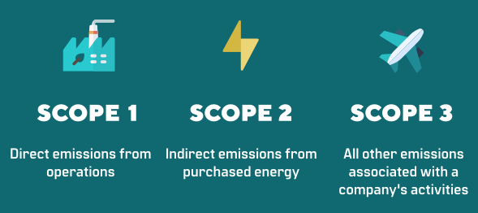
Standard for a GHG Emissions Analysis
The global standard for GHG accounting is the GHG Protocol:
The GHG Protocol establishes comprehensive global standardized frameworks to measure and manage GHG emissions from private and public sector operations, value chains, and mitigation actions.
The GHG Protocol’s standards, tools and online training helps countries and cities track progress towards their climate goals.

